Slide 1
Homework 7 – Bursting Phenomenon
Yi Chen
4/26/2020

Slide 2
Control Objective
Given reference signal, design an adaptive controller to track it.
Simulate bursting phenomenon given disturbances.
Ensure stability with presence of disturbances

Slide 3
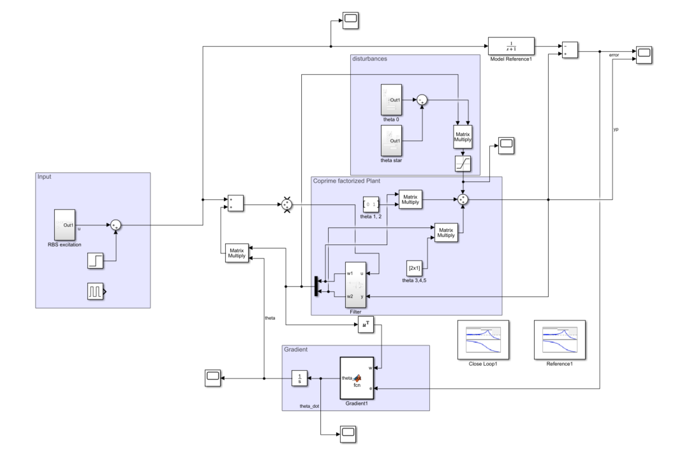
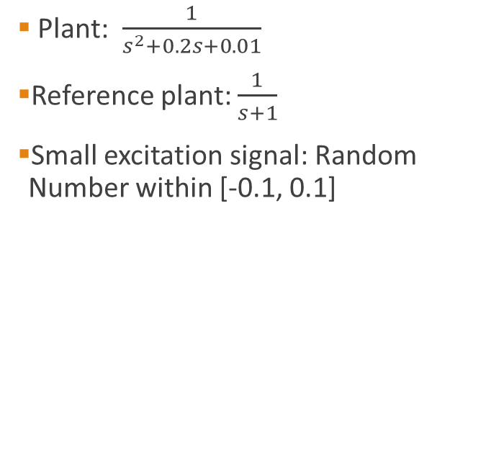
System setup – MRAC with coprime factorization and input disturbances
Plant: $\frac{1}{s^{2}+0.2s+0.01}$
Reference plant: $\frac{1}{s+1}$
Small excitation signal: Random Number within [-0.1, 0.1]
disturbances
Input + excitation
coprime
gradient

Slide 4
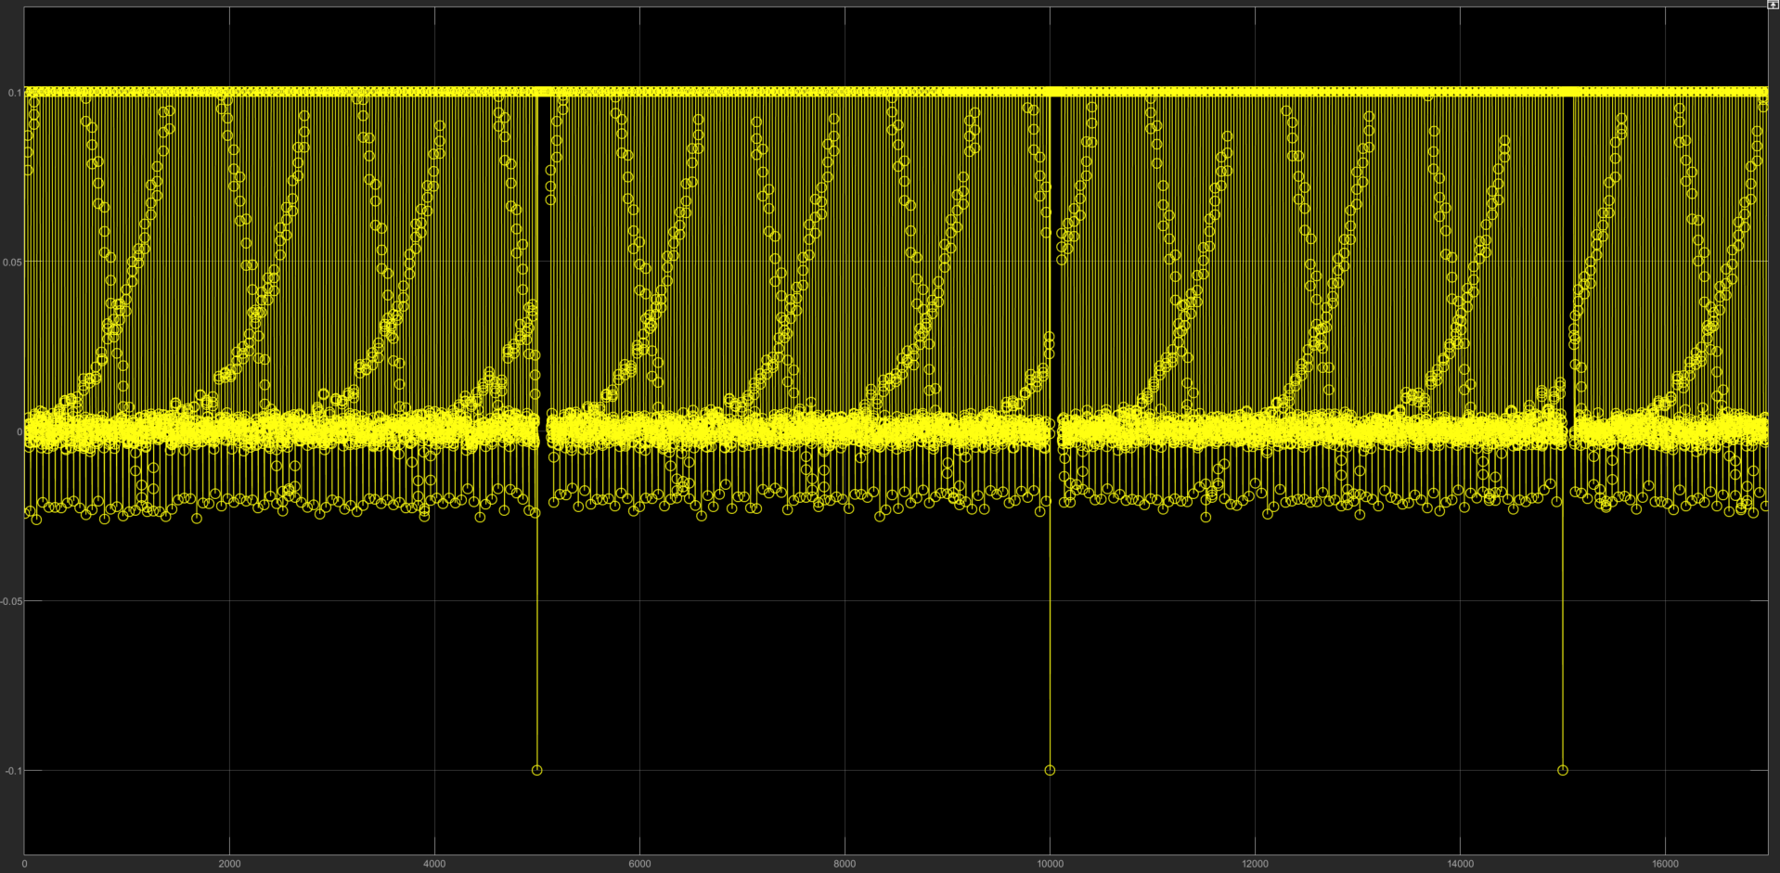
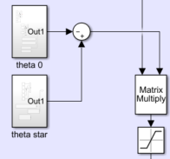
Disturbance design
We design the disturbances from the following:
theta_star: [0 1 0.2 0.01]
Theta_0: [0 0.8 0.5 0.01]
Saturation: 0.1
w
Disturbance signal after saturation

Slide 5
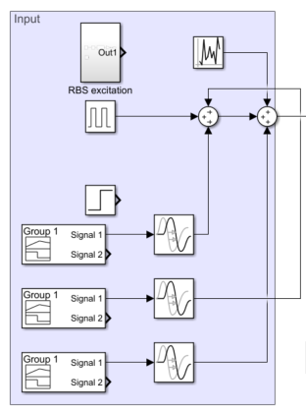
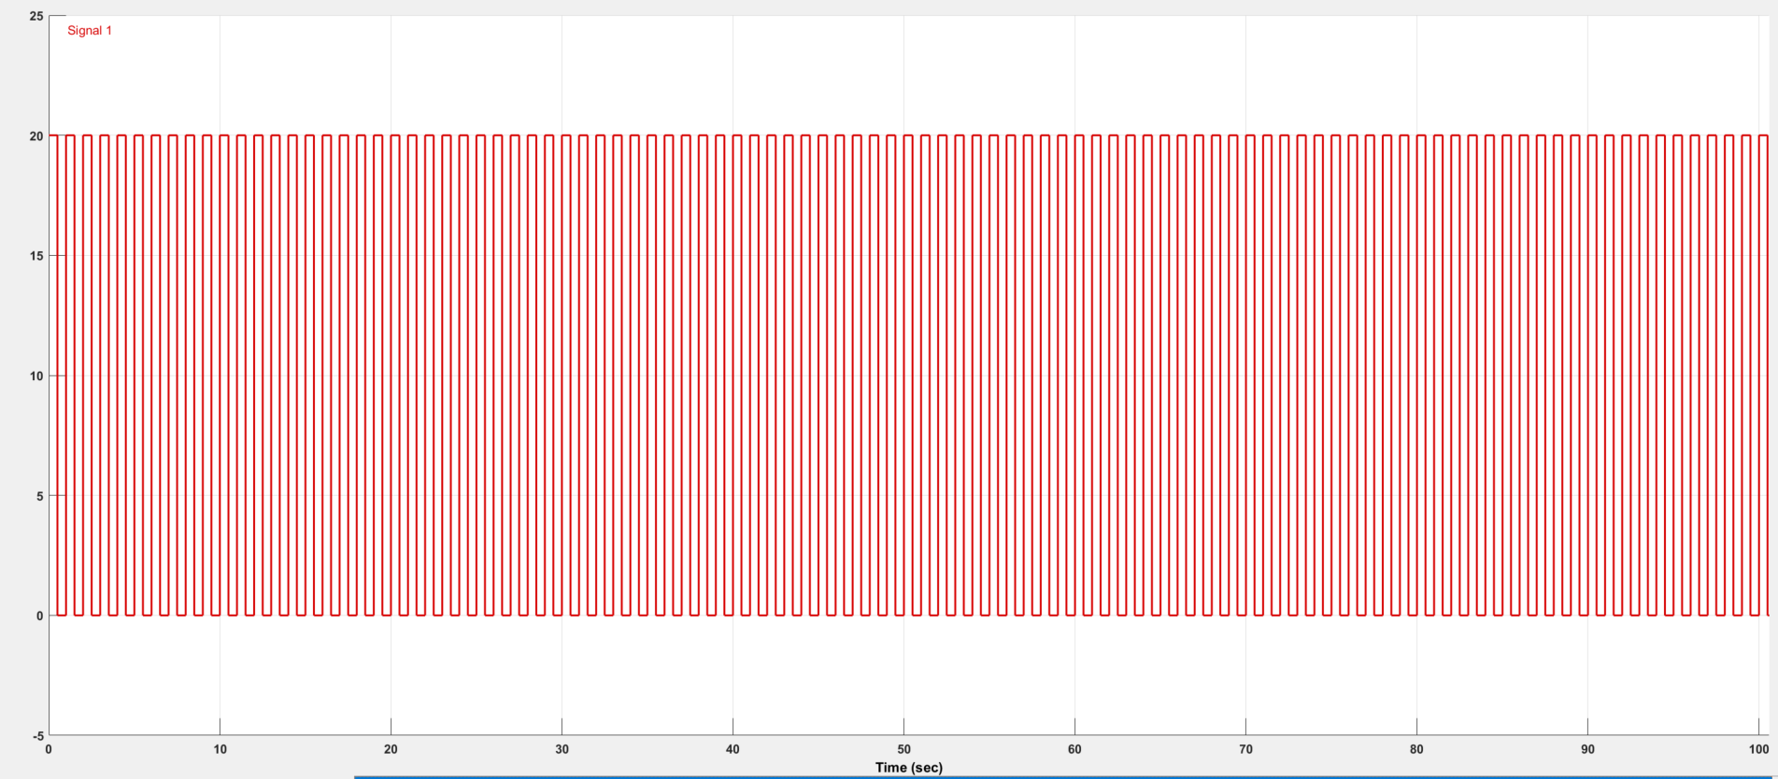
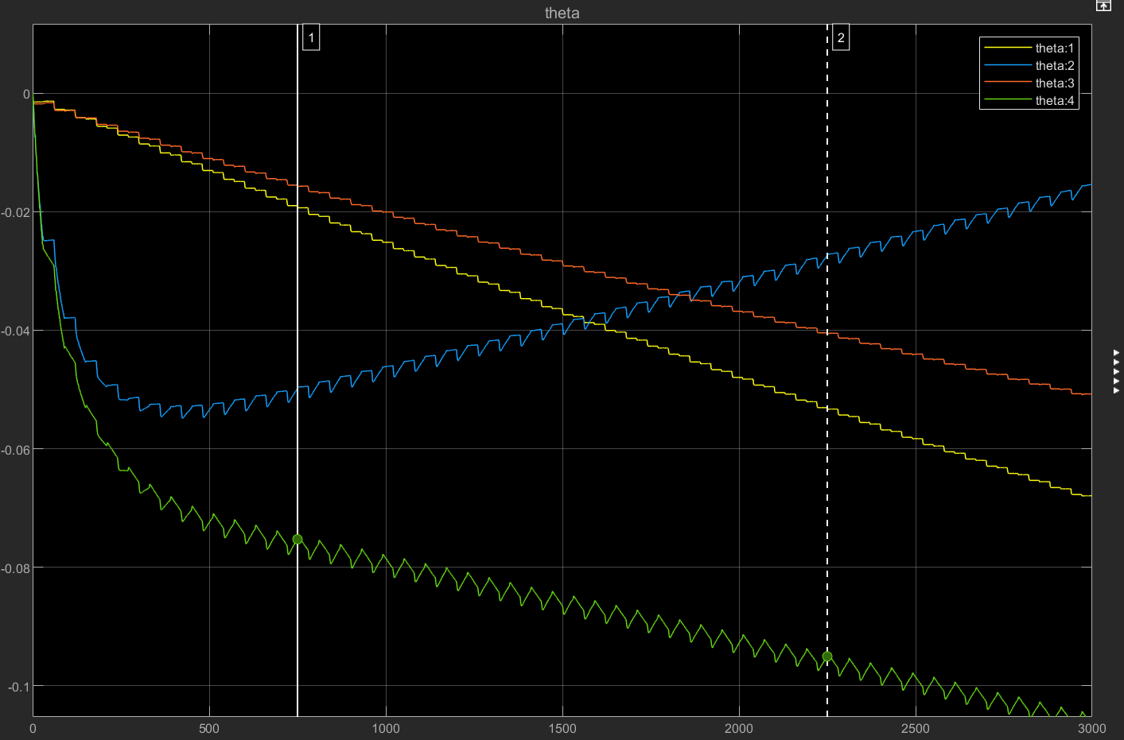

Parameter drifting
Excitation signals
To simulate burst phenomenon, we need the parameters to start drifting
Then we inject higher order excitation than the original one to pull the parameter back
Excitation injection should be in O(1), versus the small excitation in O($δ$)
Frequency: 1Hz
Duration: 100s
Excitation injection:
Amplitude: 10
Params with no excitation injection

Slide 6
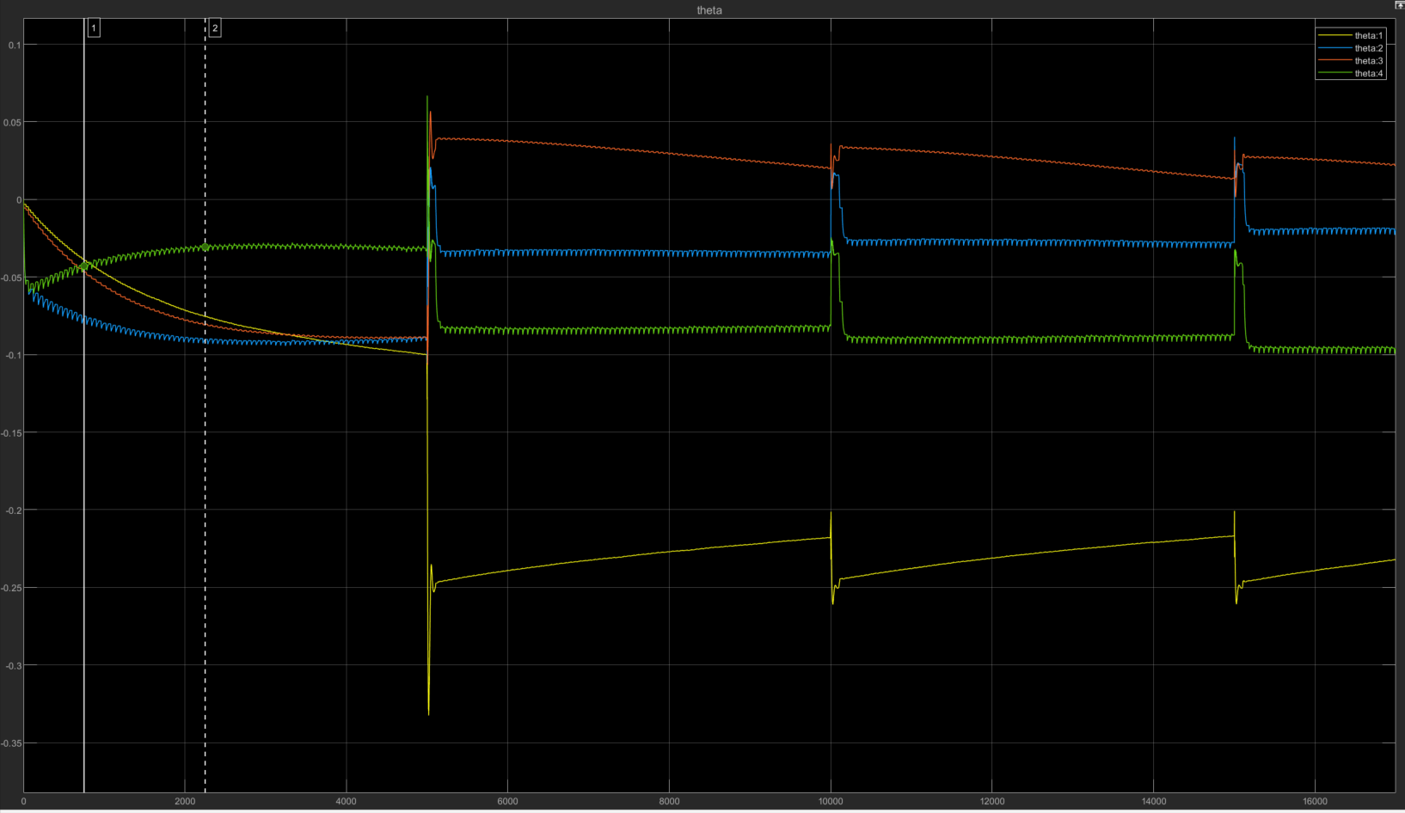
Burst Phenomenon
The simulation was ran for 17000 seconds. Excitations were injected around t = 5000, 10000, 15000.
The plot shows that the parameter quickly converge to a value given a large excitation injection.
The parameters were left untouched for the first 5000 seconds to observe its behavior. After that, periodic injections were introduced when parameters reach certain parameters.
Drifting phase
bursts
Theta as output of gradient

Slide 7
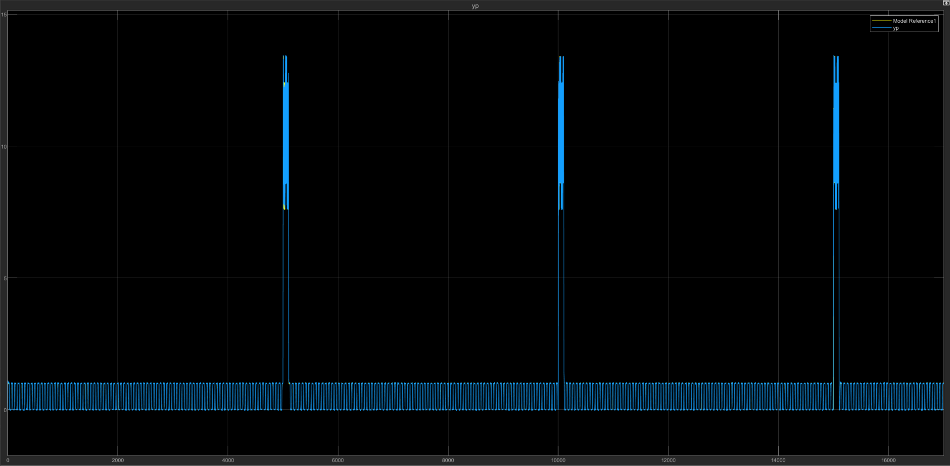
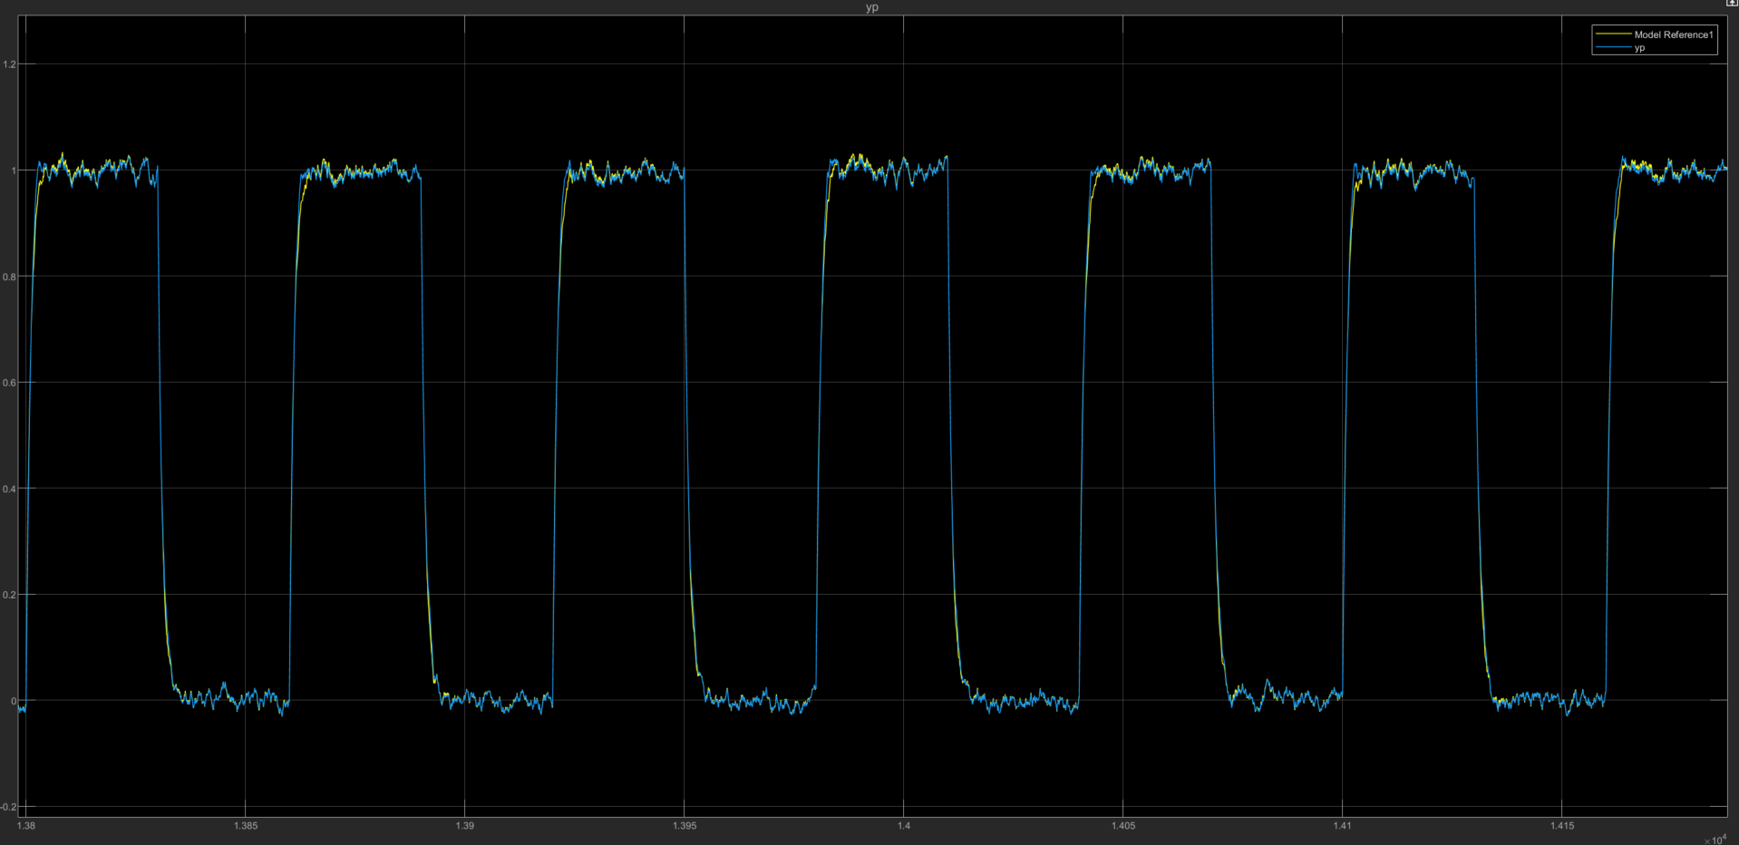
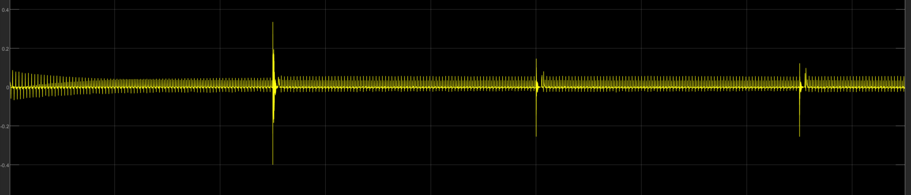
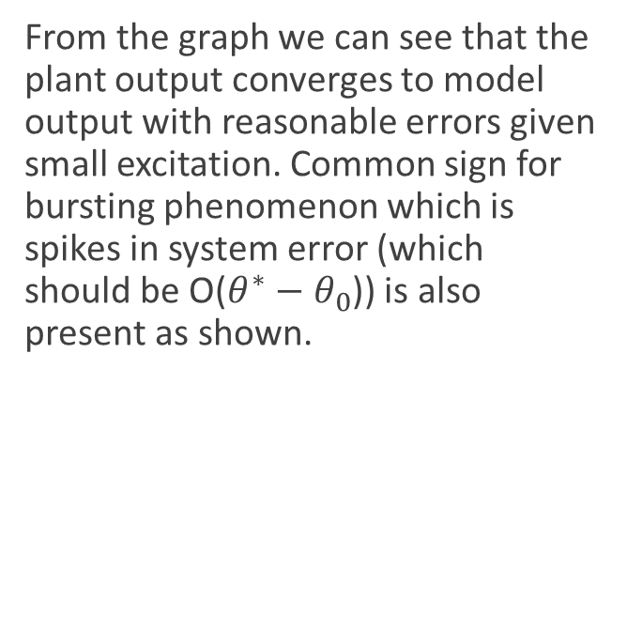
System output
From the graph we can see that the plant output converges to model output with reasonable errors given small excitation. Common sign for bursting phenomenon which is spikes in system error (which should be O($θ^{∗}−θ_{0}$)) is also present as shown.
Plant output(yp) and model output(ym)
Enlarged: yp and ym
We can see the error spikes during the bursting phase.
system error (yp-ym)

Slide 8
Summary
To simulate burst phenomenon with less trial and error, coprime factorized plant was implemented to inject disturbances with the source of parameter deviation.
The parameters quickly converged to a set of parameters when large excitation signals were injected.
Signs of a bursting phenomenon were captured in the system error

